Slide 1

Advanced Analysis of Algorithms

Slide 2
Time Complexity of Algorithms
(Asymptotic Notations)

Slide 3
Today Covered
Major Factors in Algorithms Design
Complexity Analysis
Growth of Functions
Asymptotic Notations
Usefulness of Notations
Reflexivity, Symmetry, Transitivity Relations over Θ, Ω, O, ω and o
Relation between Θ, Ω and O
Various Examples Explaining each concept

Slide 4
What is Complexity?
The level in difficulty in solving mathematically posed problems as measured by
  The time
  (time complexity)
  number of steps or arithmetic operations
  (computational complexity)
  memory space required
  (space complexity)

Slide 5
Major Factors in Algorithms Design
1. Correctness
An algorithm is said to be correct if
For every input, it halts with correct output.
An incorrect algorithm might not halt at all OR
It might halt with an answer other than desired one.
Correct algorithm solves a computational problem
2. Algorithm Efficiency
Measuring efficiency of an algorithm,
do its analysis i.e. growth rate.
Compare efficiencies of different algorithms for the same problem.

Slide 6
Algorithms Growth Rate
Algorithm Growth Rates
It measures algorithm efficiency
What means by efficient?
If running time is bounded by polynomial in the input
Notations for Asymptotic performance
How running time increases with input size
O, Omega, Theta, etc. for asymptotic running time
These notations defined in terms of functions whose domains are natural numbers
convenient for worst case running time
Algorithms, asymptotically efficient best choice

Slide 7
Complexity Analysis
Algorithm analysis means predicting resources such as
  computational time
  memory
  computer hardware etc
Worst case analysis
  Provides an upper bound on running time
  An absolute guarantee
Average case analysis
  Provides the expected running time
  Very useful, but treat with care: what is “average”?
    Random (equally likely) inputs
    Real-life inputs

Slide 8
Worst-case Analysis
Let us suppose that
D_{n} = set of inputs of size n for the problem
I = an element of D_{n}.
t(I) = number of basic operations performed on I
Define a function W by
W(n) = max{t(I) | I ∈ D_{n}}
called the worst-case complexity of the algorithm
W(n) is the maximum number of basic operations performed by the algorithm on any input of size n.
Please note that the input, I, for which an algorithm behaves worst depends on the particular algorithm.

Slide 9
Average Complexity
Let Pr(I) be the probability that input I occurs.
Then the average behavior of the algorithm is defined as
A(n) = ΣPr(I) t(I), summation over all I ∈ D_{n}
We determine t(I) by analyzing the algorithm, but Pr(I) cannot be computed analytically.
Average cost =
A(n) = Pr(succ)Asucc(n) + Pr(fail)Afail(n)
An element I in D_{n} may be thought as a set or equivalence class that affect the behavior of the algorithm
Worst Analysis computing average cost
Take all possible inputs, compute their cost, take average

Slide 10
Asymptotic Notations Properties
Categorize algorithms based on asymptotic growth rate e.g. linear, quadratic, polynomial, exponential
Ignore small constant and small inputs
Estimate upper bound and lower bound on growth rate of time complexity function
Describe running time of algorithm as n grows to ∞.
Describes behavior of function within the limit.
Limitations
not always useful for analysis on fixed-size inputs.
All results are for sufficiently large inputs.

Slide 11
Asymptotic Notations
Asymptotic Notations Θ, O, Ω, o, ω
We use Θ to mean “order exactly”,
O to mean “order at most”,
Ω to mean “order at least”,
o to mean “tight upper bound”,
ω to mean “tight lower bound”,
Define a set of functions: which is in practice used to compare two function sizes.

Slide 12
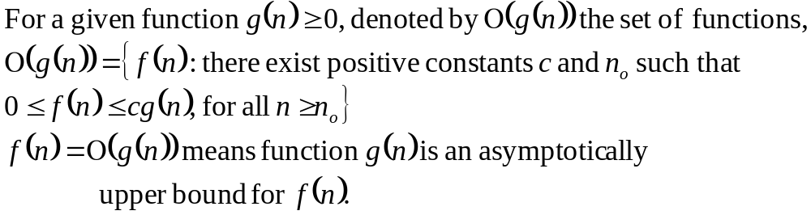
Big-Oh Notation (O)
If f, g: N → R⁺, then we can define Big-Oh as
We may write f(n) = O(g(n)) OR f(n) ∈ O(g(n))
Intuitively:
Set of all functions whose rate of growth is the same as or lower than that of g(n).

Slide 13

Big-Oh Notation
f(n) ∈ O(g(n))
∃ c > 0, ∃ n₀ ≥ 0 and ∀n ≥ n₀, 0 ≤ f(n) ≤ c.g(n)
g(n) is an asymptotic upper bound for f(n).

Slide 14
Examples
Examples
Example 1: Prove that 2n² ∈ O(n³)
Proof:
Assume that f(n) = 2n² , and g(n) = n³
f(n) ∈ O(g(n)) ?
Now we have to find the existence of c and n₀
f(n) ≤ c.g(n)  2n² ≤ c.n³  2 ≤ c.n
if we take, c = 1 and n₀= 2 OR
c = 2 and n₀= 1 then
2n² ≤ c.n³
Hence f(n) ∈ O(g(n)), c = 1 and n₀= 2

Slide 15
Examples
Examples
Example 2: Prove that n² ∈ O(n²)
Proof:
Assume that f(n) = n² , and g(n) = n²
Now we have to show that f(n) ∈ O(g(n))
Since
f(n) ≤ c.g(n)  n² ≤ c.n²  1 ≤ c, take, c = 1, n₀= 1
Then
n² ≤ c.n² for c = 1 and n ≥ 1
Hence, 2n² ∈ O(n²), where c = 1 and n₀= 1

Slide 16
Examples
Examples
Example 3: Prove that 1000.n² + 1000.n ∈ O(n²)
Proof:
Assume that f(n) = 1000.n² + 1000.n, and g(n) = n²
We have to find existence of c and n₀ such that
0 ≤ f(n) ≤ c.g(n)  n ≥ n₀
1000.n² + 1000.n ≤ c.n² = 1001.n², for c = 1001
1000.n² + 1000.n ≤ 1001.n²
1000.n ≤ n²  n² ≥ 1000.n  n² - 1000.n ≥ 0
n (n-1000) ≥ 0, this true for n ≥ 1000
f(n) ≤ c.g(n)  n ≥ n₀ and c = 1001
Hence f(n) ∈ O(g(n)) for c = 1001 and n₀ = 1000

Slide 17
Examples
Examples
Example 4: Prove that n³  O(n²)
Proof:
On contrary we assume that there exist some positive constants c and n₀ such that
0 ≤ n³ ≤ c.n²  n ≥ n₀
0 ≤ n³ ≤ c.n²  n ≤ c
Since c is any fixed number and n is any arbitrary constant, therefore n ≤ c is not possible in general.
Hence our supposition is wrong and n³ ≤ c.n²,
 n ≥ n₀ is not true for any combination of c and n₀. And hence, n³  O(n²)

Slide 18
Examples
Some More Examples
n² + n³ = O(n⁴)
n² / log(n) = O(n . log n)
5n + log(n) = O(n)
n^{log n} = O(n¹⁰⁰)
3^{n} = O(2^{n} . n¹⁰⁰)
n! = O(3^{n})
n +1 = O(n)
2n+1 = O(2n)
(n+1)! = O(n!)
1 + c + c² +…+ c^{n} = O(c^{n}) for c > 1
1 + c + c² +…+ c^{n} = O(1) for c < 1

Slide 19
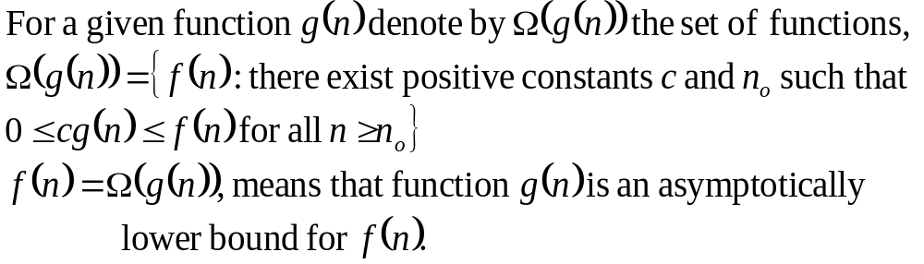
Big-Omega Notation (Ω)
If f, g: N → R⁺, then we can define Big-Omega as
We may write f(n) = Ω(g(n)) OR f(n) ∈ Ω(g(n))
Intuitively:
Set of all functions whose rate of growth is the same as or higher than that of g(n).

Slide 20

Big-Omega Notation
f(n) ∈ Ω(g(n))
∃ c > 0, ∃ n₀ ≥ 0 , ∀n ≥ n₀, f(n) ≥ c.g(n)
g(n) is an asymptotically lower bound for f(n).

Slide 21
Examples
Examples
Example 1: Prove that 5.n² ∈ Ω(n)
Proof:
Assume that f(n) = 5.n² , and g(n) = n
f(n) ∈ Ω(g(n)) ?
We have to find the existence of c and n₀ s.t.
c.g(n) ≤ f(n)  n ≥ n₀
c.n ≤ 5.n²  c ≤ 5.n
if we take, c = 5 and n₀= 1 then
c.n ≤ 5.n²  n ≥ n₀
And hence f(n) ∈ Ω(g(n)), for c = 5 and n₀= 1

Slide 22
Examples
Examples
Example 2: Prove that 5.n + 10 ∈ Ω(n)
Proof:
Assume that f(n) = 5.n + 10, and g(n) = n
f(n) ∈ Ω(g(n)) ?
We have to find the existence of c and n₀ s.t.
c.g(n) ≤ f(n)  n ≥ n₀
c.n ≤ 5.n + 10  c.n ≤ 5.n + 10.n  c ≤ 15.n
if we take, c = 15 and n₀= 1 then
c.n ≤ 5.n + 10  n ≥ n₀
And hence f(n) ∈ Ω(g(n)), for c = 15 and n₀= 1

Slide 23
Examples
Examples
Example 3: Prove that 100.n + 5 ∉ Ω(n²)
Proof:
Let f(n) = 100.n + 5, and g(n) = n²
Assume that f(n) ∈ Ω(g(n)) ?
Now if f(n) ∈ Ω(g(n)) then there exist c and n₀ s.t.
c.g(n) ≤ f(n)  n ≥ n₀ 
c.n² ≤ 100.n + 5 
c.n ≤ 100 + 5/n 
n ≤ 100/c, for a very large n, which is not possible
And hence f(n)  Ω(g(n))

Slide 24
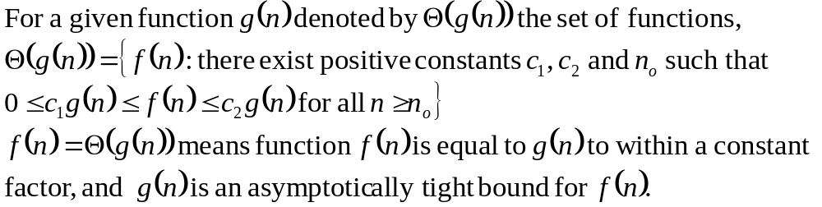
Theta Notation (Θ)
If f, g: N → R⁺, then we can define Big-Theta as
We may write f(n) = Θ(g(n)) OR f(n) ∈ Θ(g(n))
Intuitively: Set of all functions that have same rate of growth as g(n).

Slide 25

Theta Notation
f(n) ∈ Θ(g(n))
∃ c₁> 0, c₂> 0, ∃ n₀ ≥ 0, ∀ n ≥ n₀, c_{2.}g(n) ≤ f(n) ≤ c_{1.}g(n)
We say that g(n) is an asymptotically tight bound for f(n).

Slide 26
Theta Notation
Example 1: Prove that ½.n² – ½.n = Θ(n²)
Proof
Assume that f(n) = ½.n² – ½.n, and g(n) = n²
f(n) ∈ Θ(g(n))?
We have to find the existence of c₁, c₂ and n₀ s.t.
c₁.g(n) ≤ f(n) ≤ c₂.g(n)  n ≥ n₀
Since, ½ n² - ½ n ≤ ½ n² ∀n ≥ 0 if c₂= ½ and
  ½ n² - ½ n ≥ ½ n² - ½ n . ½ n ( ∀n ≥ 2 ) = ¼ n^{2,} c₁= ¼
Hence ½ n² - ½ n ≤ ½ n² ≤ ½ n² - ½ n
c₁.g(n) ≤ f(n) ≤ c₂.g(n) ∀n ≥ 2, c₁= ¼, c₂ = ½
Hence f(n) ∈ Θ(g(n)) ⇒ ½.n² – ½.n = Θ(n²)

Slide 27
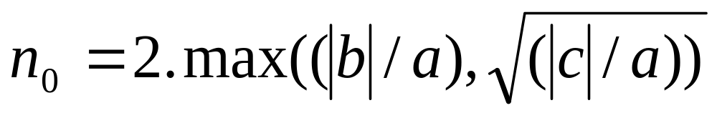
Theta Notation
Example 2: Prove that a.n² + b.n + c = Θ(n²) where a, b, c are constants and a > 0
Proof
If we take c₁ = ¼.a, c₂ = 7/4. a and
Then it can be easily verified that
0 ≤ c₁.g(n) ≤ f(n) ≤ c₂.g(n),∀n ≥ n₀, c₁= ¼.a, c₂ = 7/4.a
Hence f(n) ∈ Θ(g(n)) ⇒ a.n² + b.n + c = Θ(n²)
Hence any polynomial of degree 2 is of order Θ(n²)

Slide 28
Theta Notation
Example 1: Prove that 2.n² + 3.n + 6  Θ(n³)
Proof: Let f(n) = 2.n² + 3.n + 6, and g(n) = n³
we have to show that f(n)  Θ(g(n))
On contrary assume that f(n) ∈ Θ(g(n)) i.e.
there exist some positive constants c₁, c₂ and n₀ such that: c₁.g(n) ≤ f(n) ≤ c₂.g(n)
c₁.g(n) ≤ f(n) ≤ c₂.g(n)  c₁.n³ ≤ 2.n² + 3.n + 6 ≤ c₂. n³ 
c₁.n ≤ 2 + 3/n + 6/n² ≤ c₂. n ⇒
c₁.n ≤ 2 ≤ c₂. n, for large n ⇒
n ≤ 2/c₁ ≤ c₂/c₁.n which is not possible
Hence f(n)  Θ(g(n)) ⇒ 2.n² + 3.n + 6  Θ(n³)

Slide 29
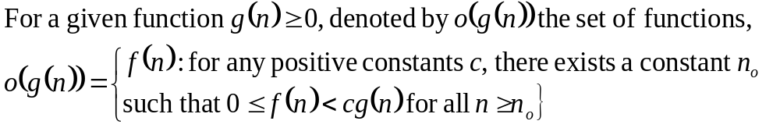
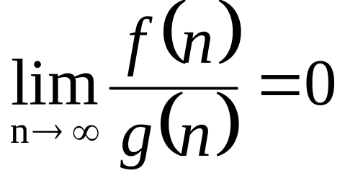
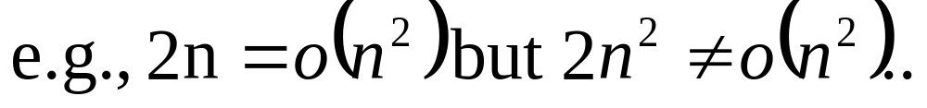
Little-Oh Notation
o-notation is used to denote a upper bound that is not asymptotically tight.
f(n) becomes insignificant relative to g(n) as n approaches infinity
g(n) is an upper bound for f(n), not asymptotically tight

Slide 30
Examples
Examples
Example 1: Prove that 2n² ∈ o(n³)
Proof:
Assume that f(n) = 2n² , and g(n) = n³
f(n) ∈ o(g(n)) ?
Now we have to find the existence n₀ for any c
f(n) < c.g(n) this is true
 2n² < c.n³  2 < c.n
This is true for any c, because for any arbitrary c we can choose n₀ such that the above inequality holds.
Hence f(n) ∈ o(g(n))

Slide 31
Examples
Examples
Example 2: Prove that n² ∉ o(n²)
Proof:
Assume that f(n) = n² , and g(n) = n²
Now we have to show that f(n) ∉ o(g(n))
Since
f(n) < c.g(n)  n² < c.n²  1 ≤ c,
In our definition of small o, it was required to prove for any c but here there is a constraint over c . Hence, n² ∉ o(n²), where c = 1 and n₀= 1

Slide 32
Examples
Examples
Example 3: Prove that 1000.n² + 1000.n ∉ o(n²)
Proof:
Assume that f(n) = 1000.n² + 1000.n, and g(n) = n²
we have to show that f(n) ∉ o(g(n)) i.e.
We assume that for any c there exist n₀ such that
0 ≤ f(n) < c.g(n)  n ≥ n₀
1000.n² + 1000.n < c.n²
If we take c = 2001, then,1000.n² + 1000.n < 2001.n²
 1000.n < 1001.n² which is not true
Hence f(n) ∉ o(g(n)) for c = 2001

Slide 33
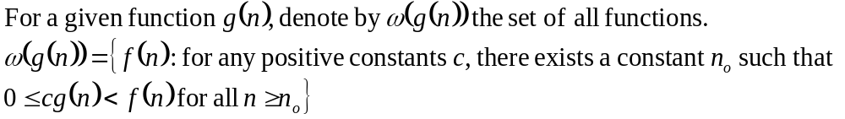
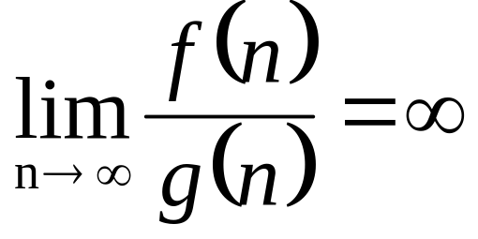
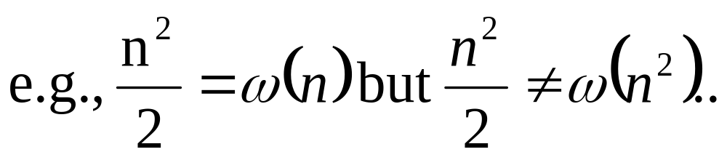
Little-Omega Notation
Little-ω notation is used to denote a lower bound that is not asymptotically tight.
f(n) becomes arbitrarily large relative to g(n) as n
approaches infinity

Slide 34
Examples
Examples
Example 1: Prove that 5.n² ∈ ω(n)
Proof:
Assume that f(n) = 5.n² , and g(n) = n
f(n) ∈ Ω(g(n)) ?
We have to prove that for any c there exists n₀ s.t., c.g(n) < f(n)  n ≥ n₀
c.n < 5.n²  c < 5.n
This is true for any c, because for any arbitrary c e.g. c = 1000000, we can choose n₀ = 1000000/5 = 200000 and the above inequality does hold.
And hence f(n) ∈ ω(g(n)),

Slide 35
Examples
Examples
Example 2: Prove that 5.n + 10 ∉ ω(n)
Proof:
Assume that f(n) = 5.n + 10, and g(n) = n
f(n) ∉ Ω(g(n)) ?
We have to find the existence n₀ for any c, s.t.
c.g(n) < f(n)  n ≥ n₀
c.n < 5.n + 10, if we take c = 16 then
16.n < 5.n + 10 ⇔ 11.n < 10 is not true for any positive integer.
Hence f(n) ∉ ω(g(n))

Slide 36
Examples
Examples
Example 3: Prove that 100.n ∉ ω(n²)
Proof:
Let f(n) = 100.n, and g(n) = n²
Assume that f(n) ∈ ω(g(n))
Now if f(n) ∈ ω(g(n)) then there n₀ for any c s.t.
c.g(n) < f(n)  n ≥ n₀ this is true
 c.n² < 100.n  c.n < 100
If we take c = 100, n < 1, not possible
Hence f(n)  ω(g(n)) i.e. 100.n ∉ ω(n²)

Slide 37
Usefulness of Notations
It is not always possible to determine behaviour of an algorithm using Θ-notation.
For example, given a problem with n inputs, we may have an algorithm to solve it in a.n² time when n is even and c.n time when n is odd. OR
We may prove that an algorithm never uses more than e.n² time and never less than f.n time.
In either case we can neither claim Θ(n) nor Θ(n²) to be the order of the time usage of the algorithm.
Big O and Ω notation will allow us to give at least partial information

